Slide 1
Update on Targeted Therapy and Immunotherapy for Cervical Cancer
Bradley J. Monk, MD
Professor and Director
Division of Gynecologic Oncology
Department of Obstetrics and Gynecology
Creighton University School of Medicine at St. Joseph’s Hospital and Medical Center, a Dignity Health Member
University of Arizona Cancer Center-Phoenix, Arizona USA
Bradley.monk@chw.edu

Slide 2
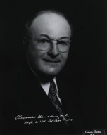
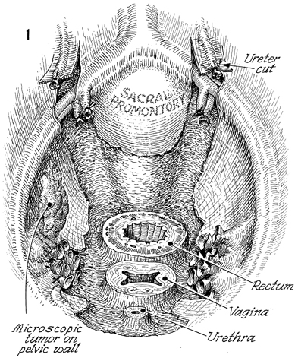
Alexander Brunschwig Total Pelvic Exenteration for Isolated Central Recurrences
1901-1969
Brunschwig A. Cancer. 1948;1(2):177-183.

Slide 3
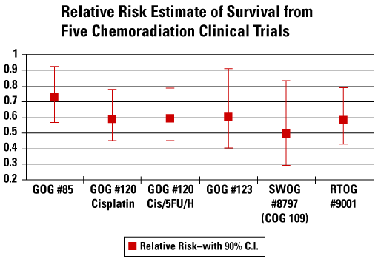
5 Pivotal Trials of Chemoradiation
National Cancer Institute Clinical Announcement 1999: www.cancer.gov/cancertopics/types/cervical
Morris M, et al. N Engl J Med. 1999;340(15):1137-1143. Rose PG, et al. N Engl J Med. 1999;340(15):1144-1153.
Keys HM, et al. N Engl J Med. 1999;340(15):1154-1161. Whitney CW, et al. J Clin Oncol. 1999;17(5):1339-1348.
Peters WA 3rd, et al. J Clin Oncol. 2000;18(8):1606-1613.

Slide 4
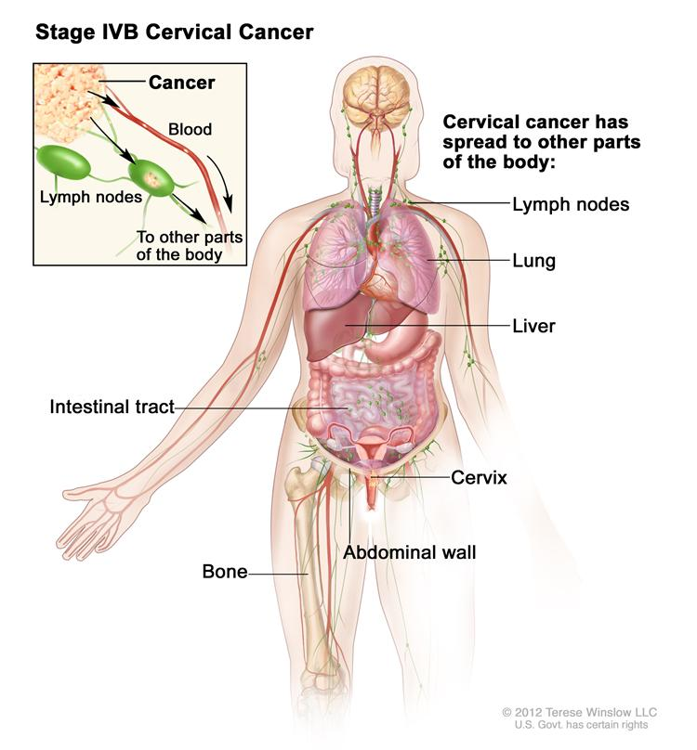
Recurrent/Persistent and Metastatic Disease: A HIGH UNMET CLINICAL NEED!

Slide 5
Recurrent and Metastatic Cervical Cancer
Cisplatin (Cis) 50 mg/m2 plus paclitaxel (Pac) 135 mg/m2 standard therapy
Median overall survival (OS) ≤12 months
Majority of patients with recurrent cervical cancer treated with cisplatin-based chemoradiation for locally advanced disease (1999 onwards)
Concern that acquired drug resistance may make platinum-based therapies less effective for recurrent cervical cancer
Gynecologic Oncology Group (GOG) 204 (2009)*
Phase III randomized trial of 4 platinum-based chemotherapy doublets
Closed for futility
Cisplatin plus paclitaxel remained standard
New therapeutic options needed
Non-platinum chemotherapy doublets?
Anti-angiogenesis therapy?
Tewari KS, et al. Curr Oncol Rep. 2005;7(6):419-434. Monk BJ, et al. J Clin Oncol. 2007;25(20):2952-2965. Tewari KS, et al. Onkologie. 2008;32(10):552-554. *Monk BJ, et al. J Clin Oncol. 2009;27(28):4649-4655. Tewari KS, et al. Semin Oncol. 2009;36(2):170-180. Tewari KS, et al. Clin Adv Hematol Oncol. 2010;8(2):108-115. Tewari KS. Am J Hematol Oncol. 2010;9:31-34. Tewari KS. Clin Ovarian Cancer. 2011;4:90-93.
Notes:
Cervical cancer is the sixth most common cancer among females in Europe, with nearly 55,000 new cases diagnosed annually. Rates are highest in Romania and lowest in Switzerland. Since the NCI’s Clinical Alert in 1999, cisplatin-based chemoradiation has been widely adopted for treatment of locally advanced disease. Unfortunately, most women with recurrent cervical cancer have acqruired drug resistance to platinum from prior exposure and therapeutic options are limited. The combination of cisplatin plus paclitaxel has remained the standard frist-line regimen for recurrent and metastatic disease based on the results of GOG protocol 204 in which 3 other platinum-based chemotherapy doublets were not able to outperform cisplatin plus paclitaxel. However, median OS is less than or equal to 12 months with this regimen. There is a need for new therapeutic alternatives. Both non-platinum chemotherapy doublets and anti-angiogenesis therapy were considered.

Slide 6
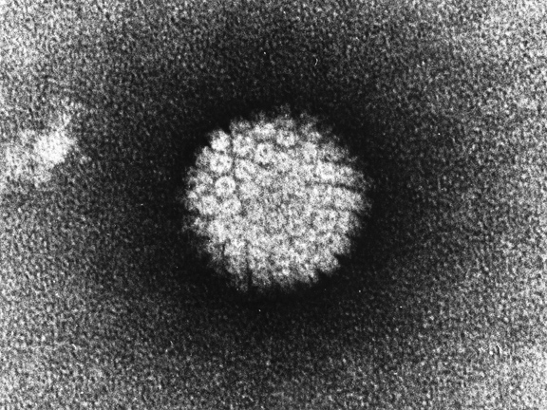
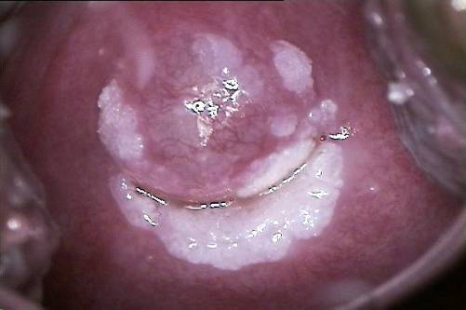
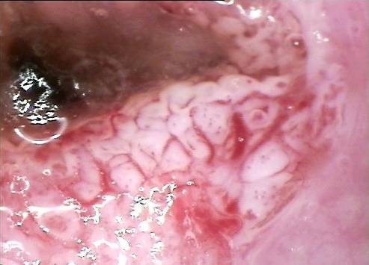
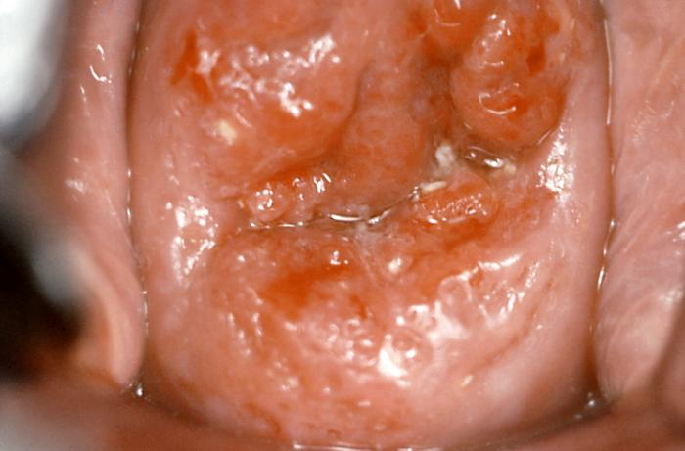
HPV Infection + Angiogenesis = Progressive Cervical Neoplasia
Transient infection Persistent infection
Normal → Precancerous, potential to regress or persist to severe disease → Invasive
HPV infection | CIN 1,2 | CIN 2,3¹ | Cervical cancer²
 |  | 7-10 years¹ | ≥10 years²
Colposcopy demonstrates abnormal vasculature and angiogenesis dependent progression of cervical neoplasia
CIN, cervical intraepithelial neoplasia; HPV, human papillomavirus
1. Schiffman M, et al. J Int Cancer Natl Monogr. 2003;31:14-19. 2. Ostör AG. Int J Gynecol Pathol. 1993;12(2):186-192.
Notes:
6
Cervical cancer is the second most common cancer in women worldwide, and persistent infection with human papillomavirus (HPV) causes almost all cases.¹ There are more than 100 types of HPV, 40 of which can be sexually transmitted.²
There are low-risk and high-risk (HR) types of HPV, with the predominant HR types being HPV 16 and 18.¹
Persistent infection with HR HPV strains for years or decades is the primary risk factor for cervical cancer.^{1,3} Women with persistent HR HPV infection are 300 times more likely to develop high-grade lesions.³
Most HPV infections are transient, with clearance from initial detection of infection or cervical intraepithelial neoplasia (CIN) 1,2 occurring within 1 to 2 years.^{1,3,4} HPV clearance from CIN 2,3 (precancer), which develops within 7 to 10 years, is less common.^{1,2}
Presence of CIN 2,3 is associated with development of invasive cervical cancer, which in most cases occurs 10 years or more after initial infection.⁵
References
1. Schiffman M et al. Human papillomavirus and cervical cancer. Lancet. 2007;370:890-907.
2. Schiffman M, Kjaer SK. Chapter 2: Natural history of anogenital human papillomavirus infection and neoplasia. J Natl Cancer Inst Monogr. 2003;31:14-19.
3. Bory JP et al. Recurrent human papillomavirus infection detected with the hybrid capture II assay selects women with normal cervical smears at risk for developing high grade cervical lesions: a longitudinal study of 3,091 women. Int J Cancer. 2002;102:519-525.
4. Nobbenhuis MA et al. Relation of human papillomavirus status to cervical lesions and consequences for cervical-cancer screening: a prospective study. Lancet. 1999;354:20-25.
5. Ostör AG. Natural history of cervical intraepithelial neoplasia: a critical review. Int J Gynecol Pathol. 1993;12:186-192.

Slide 7
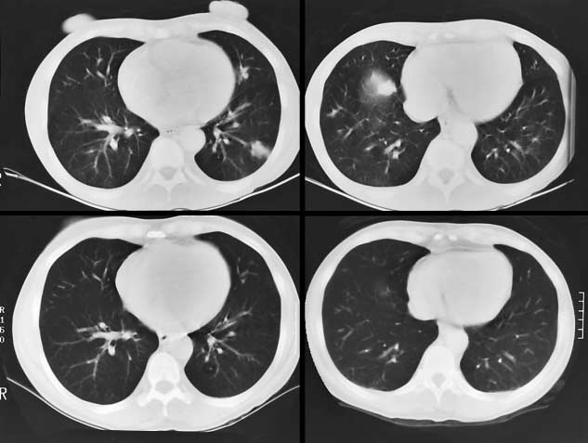
Complete Remission of Metastatic Cervical Cancer With the Angiogenesis Inhibitor TNP-470
Potent fungal metabolite first isolated from Aspergillus fumigatus with anti-angiogenesis properties
Kudelka AP, et al. N Engl J Med. 1998;338(14):991-992.
Notes:
potent fungal metabolite first isolated from Aspergillus fumigatus.

Slide 8
Mechanism of Action of Early Anti-Vascular Agents
Bevacizumab (Bev)
Anti-angiogenesis
VEGF-A
VEGFR-2
PDGFR-
PDGFR-ß
VEGFR-1
VEGFR-3
C-Kit
Flt3
Pazopanib
Sorafenib
Sunitinib
Raf
Notes:
SPEAKER’s NOTES: slides builds
Pazopanib has a different spectrum of activity vs existing agents
This profile may result in differing efficacy & toxicity profiles;
Promising tolerability profile
Easier to combine with chemotherapy and targeted agents
Pazopanib has an extensive, parallel and innovative development programme
Combination with other targeted agents, including Tykerb, provides opportunity to replace chemotherapy

Slide 9
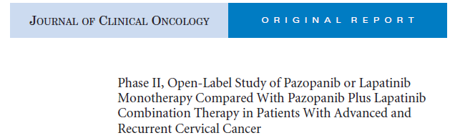
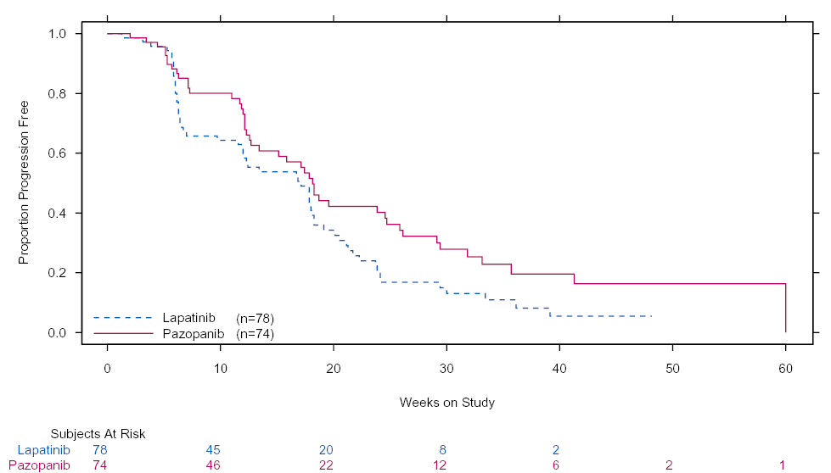
Progression-free survival (PFS): ITT
Anti-VEGF Out Performs Anti- EGF
Median PFS, weeks
Lapatinib | 17.1
Pazopanib | 18.1
HR (90% CI) | 0.66 (0.48,0.91)
P value | P = .013
**The CI are 90% (alpha = 10%) naïve CIs. *Wald normal approximation is used to calculate the 1-sided P value. ***Stratified log-rank P value and hazard ratio (Pike) adjusted only for one of the stratification factors – prior chemotherapy.
VEGF, vascular endothelial growth factor; EGF, epidermal growth factor; ITT, intent-to-treat
Monk BJ, et al J Clin Oncol. 2010;28(22):3562-3569.

Slide 10
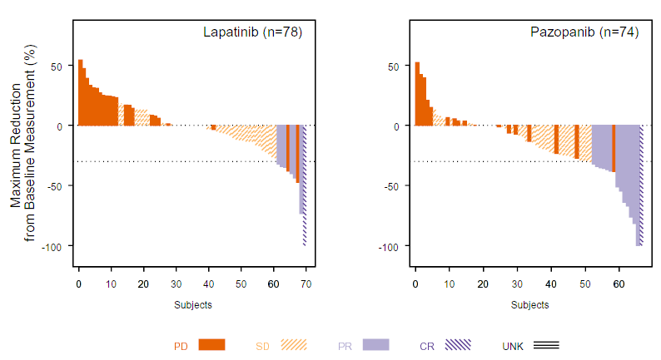
Maximum decrease in target lesion diameter: Lapatinib vs Pazopanib
Anti-VEGF Out Performs Anti- EGF
Monk BJ, et al J Clin Oncol. 2010;28(22):3562-3569.

Slide 11
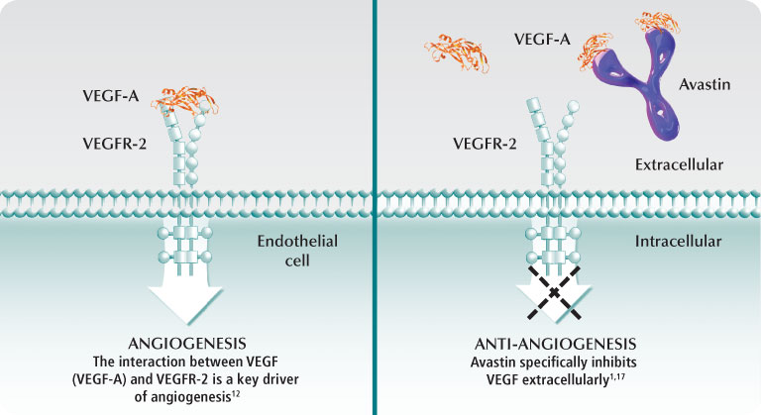
GOG 227C Phase II Bevacizumab, Recurrent Cervical Cancer
Monk BJ, et al. J Clin Oncol. 2009;27(7):1069-1074.

Slide 12
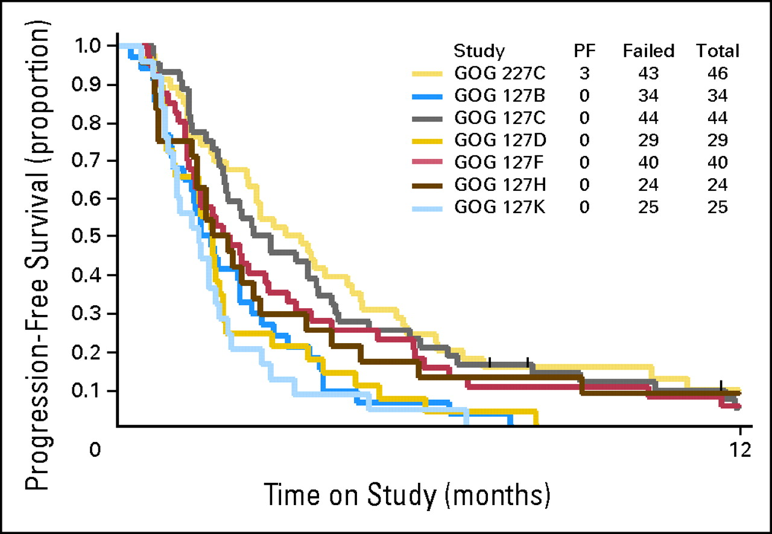
GOG 227C Phase II Bevacizumab, Recurrent Cervical Cancer
PFS by treatment group
PFS of Bev versus GOG historical database (failing one or two cytotoxic
regimens, not including
chemo-radio-therapy (RT)
Bevacizumab
GOG historical database (failing one or two cytotoxic regimens, not including chemo-RT)
Monk BJ, et al. J Clin Oncol. 2009;27(7):1069-1074.

Slide 13



GOG 240: Schema
I
Paclitaxel 135 or 175 mg/m² IV
Cisplatin 50 mg/m² IV
Carcinoma of the cervix
Primary stage IVB
Recurrent/persistent
Measureable disease
GOG PS 0-1
No prior chemotherapy for recurrence
(N = 452)
R
A
N
D
O
M
I
Z
E
Paclitaxel 135 or 175 mg/m² IV
II
Cisplatin 50 mg/m² IV
Bevacizumab 15 mg/kg IV
q21d Rx to PD, toxicity, CR
III
Paclitaxel 175 mg/m² IV
Topotecan (Topo) 0.75 mg/m² d1-3
Stratification factors:
Stage IVB vs recurrent/ persistent disease
Performance status
Prior cisplatin Rx as radiation-sensitizer
1:1:1:1
Paclitaxel 175 mg/m² IV
IV
Topotecan 0.75 mg/m² d1-3
Bevacizumab 15 mg/kg IV
Activated: 4/6/09
Closed to accrual: 1/3/12
United States,
Canada & Spain
CR, complete response; PD, progressive disease; PS, performance status; q21d, every 21 days; Rx, treatment
National Institutes of Health. Available at: http://clinicaltrials.gov/ct2/show/NCT00803062. Accessed January 7, 2015.
Notes:
GOG 240 was conducted in the United States and in Spain. The schema is presented here. Patients were randomized equally among 4 treatment arms. Note that regimens 1 and 3 contain chemotherapy alone and regimens 2 and 4 contain the chemotherapy plus bevacizumab at 15 mg/kg. In addition to the incorporation of anti-VEGF therapy using single agent bevacizumab, we also studied the integration of the non-platinum chemotherapy doublet of topotecan plus paclitaxel based on laboratory data demonstrating synergy between topotecan and microtubule-interfering agents and a phase II trial in which the regimen was active in this population. In GOG 240, patients were treated every 21 days until progression, unacceptable toxicity, or complete response.

Slide 14
GOG 240: Statistical Considerations
Phase III open-label study
2 x 2 factorial design with 2 primary independent hypotheses tested
The impact of non-platinum doublets compared with a platinum doublet
The impact of the addition of anti-angiogenic therapy to chemotherapy
Assumptions for the primary end point of overall survival (OS)
Sample size = 450
Assumes no evidence of interaction between factors
346 deaths required to detect a reduction in the hazard of death by 30% by the addition of either factor with a power of 90%
2.5% alpha for each of the 2 primary hypothesis tests
Goal to increase median OS from 12 months to 16 months
Pre-planned interim analysis after 173 events to determine futility or superiority of either experimental factor
2 sequential 2-stage toxicity analyses to monitor for unacceptable toxicity in the experimental arms
National Institutes of Health. Available at: http://clinicaltrials.gov/ct2/show/NCT00803062. Accessed January 7, 2015.
Notes:
Assuming absence of interaction between the experimental agents, the study utilized a 2x2 factorial design to investigate the impact of anti-VEGF therapy and the substitution of topotecan for cisplatin. The study employed the intent to treat principle. Patients were prospectively stratified by GOG performance status, prior radiosensitizing platinum, and disease status (recurrence/persistence versus stage IV primary). Differences in OS and PFS by factor level were assessed primarily by the long-rank test, stratified by prognostic factors and the level of the other factor. Hazard ratios (HR) were estimated with a Cox proportional hazards model.
A sample size of approximately 450 was accrued to potentially observe 346 deaths in final analysis to provide a study with 90% power when either factor was capable of reducing the hazard of death by at least 30%, while limiting the one-sided type I error for each to 2.5%. An interim analysis was scheduled near 173 deaths to drop a factor or to stop the study for futility or to report regimen activity early according to the spending function. 2 two-stage sequential toxicity analyses were used to monitor for unacceptable toxicity in the experimental arms.

Slide 15
GOG 240: Study Timeline, Part 1
January 2, 2012
Target accrual reached (N = 452)
Trial Design
Cervix Committee (GOG)
Protocol Development Comm (GOG)
Cervical Cancer Task Force
Gynecologic Cancer Steering Comm
GEICO
Genentech/Roche
Central IRB
CTEP
February 6, 2012
174 deaths (events), planned interim analysis
March 13, 2012
Release of non-superiority of topotecan-paclitaxel backbone by NCI DMC & GOG
April 9, 2009
Trial activation
2006-2008
2009-2011
2012
Comm, Committee; CTEP, Cancer Therapy Evaluation Program; IRB, institutional review board; GEICO, Spanish Ovarian Cancer Research Group
Notes:
GOG 240 activated on April 9, 2009. On February 6th, 2012 the database was frozen with 174 events observed. This triggered the pre-planned interim analysis. The DMC was convened and the members voted to release the topotecan plus paclitaxel data.
What I will say: GOG 240 was activated on 4/9/09 and on 2/6/12 the data base was frozen for the interim analysis. The DMC voted to release the topotecan-paclitaxel data.

Slide 16


GOG 240.1
Phase III Randomized Clinical Trial of Cisplatin Plus Paclitaxel vs the Non-Platinum Chemotherapy Doublet of Topotecan Plus Paclitaxel in Women With Recurrent, Persistent, or Metastatic Cervical Carcinoma: A Gynecologic Oncology Group Study
KS Tewari, M Sill, HJ Long III, L Ramondetta, L Landrum, A Oaknin, T Reid, M Leitao, H Michael, BJ Monk
Presented at: The Society of Gynecologic Oncology’s (SGO) 2013 Annual Meeting on Women’s Cancer
Abstract 1
SGO Presidential Award for Most Outstanding Scientific Abstract Hugh Barber Lectureship Designation

Slide 17
GOG 240.1: Schema
I
Paclitaxel 135 or 175 mg/m² IV
Cisplatin 50 mg/m² IV
Cis-paclitaxel
backbone
Carcinoma of the cervix
Primary stage IVB
Recurrent/persistent
Measureable disease
GOG PS 0-1
No prior chemotherapy for recurrence
(N = 452)
R
A
N
D
O
M
I
Z
E
Paclitaxel 135 or 175 mg/m² IV
II
Cisplatin 50 mg/m² IV
Bevacizumab 15 mg/kg IV
q21d Rx to PD, toxicity, CR
III
Paclitaxel 175 mg/m² IV
Topotecan 0.75 mg/m² d1-3
Topotecan- paclitaxel
backbone
Stratification factors:
Stage IVB vs recurrent/ persistent disease
Performance status
Prior cisplatin Rx as radiation-sensitizer
1:1:1:1
Paclitaxel 175 mg/m² IV
IV
Topotecan 0.75 mg/m² d1-3
Bevacizumab 15 mg/kg IV
Activated: 4/6/09
Closed to accrual: 1/3/12
United States,
Canada & Spain
National Institutes of Health. Available at: http://clinicaltrials.gov/ct2/show/NCT00803062. Accessed January 7, 2015.
Notes:
GOG 240 was conducted in the United States and in Spain. The schema is presented here. Patients were randomized equally among 4 treatment arms. Note that regimens 1 and 3 contain chemotherapy alone and regimens 2 and 4 contain the chemotherapy plus bevacizumab at 15 mg/kg. In addition to the incorporation of anti-VEGF therapy using single agent bevacizumab, we also studied the integration of the non-platinum chemotherapy doublet of topotecan plus paclitaxel based on laboratory data demonstrating synergy between topotecan and microtubule-interfering agents and a phase II trial in which the regimen was active in this population. In GOG 240, patients were treated every 21 days until progression, unacceptable toxicity, or complete response.

Slide 18
GOG 240.1: Results Demographics & Treatment Allocation
 | Cis + Pac backbone | Topo + Pac backbone | P value
Median age, years | 46 (20-85) | 48 (22-82) | NS
Squamous | 71% | 67% | 0.308
adenocarcinoma, unspecified | 20% | 21%
White | 78% | 77% | 0.800
African American | 13% | 13%
Asian | 5% | 4%
Pacific Islander | 0.4% | 0.00
Recurrent | 75% | 69% | 0.298
Persistent | 9% | 14%
Advanced | 16% | 17%
PS 0 | 57% | 59% | 0.703
PS 1 | 43% | 41%
Prior platinum | 76% | 74% | 0.666
TOTAL | 229 | 223 | NS
Tewari KS, et al. Presented at: The Society of Gynecologic Oncology’s 2013 Annual Meeting on Women’s Cancer; March 9-12, 2013: Los Angeles, California. Abstract 1.
Notes:
From 4/6/09 to 1/3/12, the trial accrued 452 patients. Over 220 patients were treated with each of the chemotherapy backbones, and patients were well-matched for histology, ethnicity, grade as well as disease status: recurrence vs persistence vs advanced. Importantly, 75% of the entire study group had previously received platinum and this was also evenly distributed between the 2 backbones.

Slide 19
GOG 240.1: Results Planned Interim Analysis
February 2012
174 deaths
NCI DSMB convened
Recommended release of topotecan plus paclitaxel data
‘Dear Investigator’ and ‘Dear Patient’ letters drafted
Tewari KS, et al. Presented at: The Society of Gynecologic Oncology’s 2013 Annual Meeting on Women’s Cancer; March 9-12, 2013: Los Angeles, California. Abstract 1.
Notes:
In February 2012 we had observed 174 events and this triggered the pre-planned interim analysis. The DSMB was convened by the NCI and the members voted to release the topotecan plus paclitaxel data. To notify investigators and trial participants of the topotecan/paclitaxel data, ‘Dear Investigator’ and ‘Dear Patient’ letters were drafted.

Slide 20
GOG 240.1: Interim Analysis SGO 2013 Overall Survival: Cis-Pac Backbone vs Topo-Pac Backbone
February 2012 study results released comparing non-platinum doublet vs platinum-doublet
Topotecan + paclitaxel shown to not be superior or inferior to cisplatin + paclitaxel
 | Cis + Pac (n = 229) | Topo + Pac (n = 223)
Events, n (%) | 81 (35) | 93 (42)
Median OS, months | 15 | 12.5
HR = 1.20 (98.74% CI, 0.82-1.76) P (1-sided) = .880
1.0
0.9
0.8
0.7
0.6
Proportion Surviving
0.5
0.4
0.3
0.2
0.1
0.0
0
12
24
Months on Study
Tewari KS, et al. Presented at: The Society of Gynecologic Oncology’s 2013 Annual Meeting on Women’s Cancer; March 9-12, 2013: Los Angeles, California. Abstract 1.
Notes:
The topotecan-paclitaxel data was presented at the 44th Annual Meeting of the Society of Gynecologic Oncology in March 2013. The experimental to control hazard ratio of death was 1.2 with a CI that includes 1 and a p value of 0.88. These results were interpreted as indicating that the non-platinum chemotherapy doublet was not superior to cisplatin-paclitaxel for efficacy.
What I will say: We presented the results of the interim analysis at the 44th Annual Meeting of the Society of Gynecologic Oncology in March 2013. With a HR of 1.2, we reported that the topotecan-paclitaxel backbone was not superior to the cisplatin-paclitaxel backbone.

Slide 21
GOG 240.1: Overall Survival Prior Platinum Exposure
OS, proportion
Treatment
Cisplatin
Topotecan
OS, proportion
Alive
106
92
Dead
67
72
Total
173
164
Cisplatin-paclitaxel backbone
Cisplatin-paclitaxel backbone
Topotecan-paclitaxel backbone
Topotecan-paclitaxel backbone
HR 1.35 (95% CI 0.676-2.688)
RR: 54% (Cis-Pac) vs 42% (Topo-Pac)
HR 1.18 (95% CI 0.84-1.65)
Response rate (RR): 34% (Cis-Pac) vs 24% (Topo-Pac)
Treatment
Cisplatin
Topotecan
Alive
42
38
Dead
14
21
Total
56
59
Months on Study
Months on Study
Prior Cisplatin
No Prior Cisplatin
Tewari KS, et al. Presented at: The Society of Gynecologic Oncology’s 2013 Annual Meeting on Women’s Cancer; March 9-12, 2013: Los Angeles, California. Abstract 1.
Notes:
These are the overall survival curves for patients with and without prior platinum exposure. The HR for death in patients who have received prior platinum is 1.18 as compared to 1.35 for those who did not receive prior platinum. This makes intuitive sense as the benefit of treating patients with cisplatin at recurrence is expected to be better in those patients who are chemoaive to it. However, the HR of 1.18 still “favors” the cisplatin-paclitaxel backbone but because the CI includes 1 this indicates that there is no significant evidence that topotecan is worse. Taken as a whole, the topotecan backbone failed to demonstrate superiority even among patients with prior cisplatin. The data lean in favor of the cisplatin regimens but we cannot conclusively say that cisplatin is superior.

Slide 22
GOG 240.1: Toxicity Cis-Pac Backbone vs Topo-Pac Backbone
 |  | Grade 0 | Grade 1 | Grade 2 | Grade 3 | Grade 4 | Grade 5
Leukopenia | Cis-Pac | 45 | 27 | 70 | 60 | 10 | 0
 | Topo-Pac | 30 | 28 | 42 | 71 | 33 | 0
Nausea | Cis-Pac | 82 | 78 | 36 | 16 | 0 | 0
 | Topo-Pac | 103 | 71 | 26 | 4 | 0 | 0
Vomiting | Cis-Pac | 145 | 29 | 28 | 10 | 0 | 0
 | Topo-Pac | 161 | 27 | 11 | 5 | 0 | 0
Metabolic | Cis-Pac | 115 | 42 | 28 | 26 | 1 | 0
 | Topo-Pac | 130 | 35 | 26 | 11 | 2 | 0
Neurosensory | Cis-Pac | 96 | 65 | 35 | 16 | 0 | 0
 | Topo-Pac | 87 | 82 | 30 | 5 | 0 | 0
Allergy | Cis-Pac | 172 | 16 | 17 | 7 | 0 | 0
 | Topo-Pac | 193 | 7 | 1 | 3 | 0 | 0
Tewari KS, et al. Presented at: The Society of Gynecologic Oncology’s 2013 Annual Meeting on Women’s Cancer; March 9-12, 2013: Los Angeles, California. Abstract 1.
Notes:
The proportion of severe toxicities in the topotecan arms were not sufficient to call a meeting of the DSMB or to declare the regimens unsafe. There was increased leukopenia among patients receiving the non-platinum chemotherapy doublet, but febrile neutropenia and infection with grade 3-4 neutropenia were not significantly increased.The cisplatin-paclitaxel regimens did worse by allergy, neuropathy, metabolic, and nausea/vomiting.

Slide 23
GOG 240.1: Conclusions
This is the largest phase III randomized clinical trial in this population to complete accrual
The substitution of topotecan for cisplatin does not result in improved OS
The RR for the cisplatin-paclitaxel backbone remains high
Topotecan-paclitaxel is a treatment alternative for this population
Selection of either the Cis-Pac backbone or the Topo-Pac backbone should be predicated on toxicity screening/assessment, particularly in patients with prior Cis exposure
Tewari KS, et al. Presented at: The Society of Gynecologic Oncology’s 2013 Annual Meeting on Women’s Cancer; March 9-12, 2013: Los Angeles, California. Abstract 1.
Notes:
In conclusion: this is the GOG’s 9th phase 3 randomized trial in this population and the largest to complete accrual. The substitution of topotecan for cisplatin does not result in improved OS and the RR for cisplatin-paclitaxel remains high. The non-platinum chemotherapy doublet of topotecan-paclitaxel provides a much needed treatment alternative in this vulnerable population. Toxicity assessment of individual patients may identify those who are less likely to tolerate platinum-paclitaxel and for whom topotecan-paclitaxel may be considered.

Slide 24
GOG 240: Study Timeline, Part 2
January 2, 2012
Target accrual reached (N = 452)
January 2013
Bevacizumab-containing regimens declared superior by NCI DMC and GOG
February 6, 2012
174 deaths (events), planned interim analysis
February 2013
Dear patient & Dear investigator letters; ASCO abstract submitted
March 13, 2012
Release of non-superiority of topotecan-paclitaxel backbone by NCI DMC and GOG
March 2013
ASCO makes rare exception to embargo and places abstract in public domain
April 9, 2009
Trial activation
March 9, 2013
SGO 2013 plenary of topotecan-paclitaxel backbone (abstract #1)
December 12, 2012 Database lock and analysis
June 2, 2013
ASCO 2013 press briefing and general plenary
2009-2011
2012
2013
ASCO, American Society of Clinical Oncology; chemoRx, chemotherapy treatment; DMC, data monitoring committee; NCCN, National Comprehensive Cancer Network; NCI, National Cancer Institute.
Notes:
The database was frozen again on December 12th, 2012 and it was determined that the trial had met it’s primary endpoint concerning anti-VEGF therapy. A Press Release was posted by the NCI and Dear Patient & Dear Investigators were prepared . ASCO granted a rare exception to its embargo policy to allow the abstract to appear in the public domain well ahead of the meeting. In May 2013 the National Comprehensive Cancer Network considered including the bevacizumab-containing regimens in their 2013 Update of the Cervical Cancer Clinical Practice Guidelines
What I will say: At the request of the DMC, the database was frozen again on 12/12/12, at which point it was determined that the trial had met its primary endpoint concerning anti-VEGF therapy. All of the subsequent data that will be presented are the results of the pooled analyses of chemotherapy versus chemotherapy plus bevacizumab.

Slide 25

Incorporation of Bevacizumab in the Treatment of Recurrent and Metastatic Cervical Cancer
GOG 240.2
GOG 240: A Phase 3 Randomized Trial of the Gynecologic Oncology Group
KS Tewari, MW Sill, HJ Long 3rd, RT Penson,
LM Ramondetta, LM Landrum, A Oaknin, TJ Reid,
MM Leitao, HE Michael, BJ Monk
Presented at: ASCO Annual Meeting 2013
Abstract 3

Slide 26
GOG 240: 2 Schema
I
Paclitaxel 135 or 175 mg/m² IV
Cisplatin 50 mg/m² IV
Carcinoma of the cervix
Primary stage IVB
Recurrent/persistent
Measureable disease
GOG PS 0-1
No prior chemotherapy for recurrence
(N = 452)
R
A
N
D
O
M
I
Z
E
Chemo alone
Paclitaxel 135 or 175 mg/m² IV
II
Cisplatin 50 mg/m² IV
Bevacizumab 15 mg/kg IV
q21d Rx to PD, toxicity, CR
III
Paclitaxel 175 mg/m² IV
Topotecan 0.75 mg/m² d1-3
Stratification factors:
Stage IVB vs recurrent/ persistent disease
Performance status
Prior cisplatin Rx as radiation-sensitizer
1:1:1:1
Paclitaxel 175 mg/m² IV
Chemo + Bev
IV
Topotecan 0.75 mg/m² d1-3
Bevacizumab 15 mg/kg IV
Activated: 4/6/09
Closed to accrual: 1/3/12
United States,
Canada & Spain
National Institutes of Health. Available at: http://clinicaltrials.gov/ct2/show/NCT00803062. Accessed January 7, 2015.
Notes:
GOG 240 was conducted in the United States and in Spain. The schema is presented here. Patients were randomized equally among 4 treatment arms. Note that regimens 1 and 3 contain chemotherapy alone and regimens 2 and 4 contain the chemotherapy plus bevacizumab at 15 mg/kg. In addition to the incorporation of anti-VEGF therapy using single agent bevacizumab, we also studied the integration of the non-platinum chemotherapy doublet of topotecan plus paclitaxel based on laboratory data demonstrating synergy between topotecan and microtubule-interfering agents and a phase II trial in which the regimen was active in this population. In GOG 240, patients were treated every 21 days until progression, unacceptable toxicity, or complete response.

Slide 27
GOG 240.2: Demographics & Baseline Characteristics
Characteristic | Chemo Alone (n = 225), % | Chemo + Bev (n = 227), %
Median age, years (range) | 46 (20–83) | 48 (22–85)
Histology, % Squamous Adenocarcinoma, unspec. | 68 20 | 70 19
Race, % White African American Asian Pacific Islander | 80 11 3 0 | 75 16 5 0
Stage of disease, % Recurrent Persistent Advanced | 73 10 16 | 70 12 17
Performance status, % 0 1 | 58 42 | 58 42
Prior platinum, % | 74 | 75
Pelvic disease, % | 53 | 54
Tewari KS, et al. J Clin Oncol. 2013;31(Suppl): Abstract 3.
Notes:
The original efficacy data for bevacizumab were presented at the 49th Annual Meeting of the American Society of Clinical Oncology in June 2013.
From 4/6/09 to 1/3/12, the trial accrued 452 patients. Over 220 patients were treated with either chemotherapy alone or chemotherapy plus bevacizumab. Patients were well-matched for performance status, ethnicity, histology, disease status, and in-field pelvic recurrences. Importantly, 75% of the entire study group had previously received platinum, and this was also evenly distributed between the 2 backbones.

Slide 28
GOG 240.2: Second Interim Analysis OS for Chemo vs Chemo + Bev
 | Chemotherapy (n = 225) | Chemotherapy + Bev (n = 227)
Events, n (%) | 140 (62) | 131 (58)
Median OS, months | 13.3 | 17.0
 | HR = 0.71 (97% CI, 0.54-0.94) P = .0035
1.0
0.9
0.8
0.7
0.6
Proportion Surviving
Median follow-up
20.8 months
0.5
0.4
0.3
0.2
0.1
0.0
0
12
24
36
Months on Study
Tewari KS, et al. J Clin Oncol. 2013;31(Suppl): Abstract 3.
Notes:
At ASCO 2013, we reported that the median OS was 13.3 months in the chemotherapy alone backbone and 17.0 months in the chemotherapy plus bevacizumab backbone. The estimate of the hazard of death (bevacizumab to no bevacizumab) is 0.71.

Slide 29
GOG 240.2: Second Interim Analysis PFS for Chemo vs Chemo + Bev
 | Chemotherapy (n = 225) | Chemotherapy + Bev (n=227)
Events, n (%) | 184 (82) | 183 (81)
Median PFS, months | 5.9 | 8.2
 | HR=0.67 (95% CI, 0.54–0.82) 2-sided P = .0002
1.0
0.9
0.8
0.7
0.6
RR, % | 36 (CR, n = 14) | 48 (CR, n = 28)
 | 2-sided P = .00807
Proportion Progression-Free
0.5
0.4
0.3
0.2
0.1
0.0
0
12
24
36
Months on Study
Tewari KS, et al. J Clin Oncol. 2013;31(Suppl): Abstract 3.
Notes:
We also reported that the median PFS was 5.9 months in the chemotherapy alone backbone and 8.2 months in the chemotherapy plus bevacizumab backbone. The experimental-to-control hazard of progression was significantly reduced in patients treated with bevacizumab with a hazard ratio of 0.67. The response rates of chemotherapy alone was 36% as compard to 48% with chemotherapy plus bevacizumab. There were significantly more complete responses in the chemotherapy plus bevacizumab arms.

Slide 30
GOG 240.2: OS for Cis + Pac vs Cis + Pac + Bev
 | Cis + Pac (n = 114) | Cis + Pac + Bev (n = 115)
Events, n (%) | 69 (60.5) | 67 (58.3)
Median OS, months | 14.3 | 17.517.5
 | HR = 0.68 (95% CI, 0.48-0.97) P = .0348
1.0
0.9
0.8
0.7
RR, % | 45 (CR, n = 9) | 50 (CR, n = 17)
 | 2-sided P = .5090
0.6
0.5
Proportion Surviving
0.4
0.3
0.2
0.1
0.0
0
12
24
36
Months on Study
Tewari KS, et al. J Clin Oncol. 2013;31(Suppl): Abstract 3.

Slide 31
GOG 240.2: OS and Prognostic Factors
Subgroup |  | No. of patients | Hazard ratio
Age | Age ≤40 years | 112
 | 40 <age ≤48 years | 111
 | 48 <age ≤56 years | 108
 | 56 years <age | 121
Performance status | 0 | 263
 | 1 | 189
Prior platinum RT | No | 115
 | Yes | 337
Disease status | Advanced | 76
 | Recurrent/persistent | 376
Topotecan treatment | No | 229
 | Yes | 223
Race | Not black | 392
 | Black | 60
Histology | Adenocarcinoma | 86
 | Adenosquamous | 44
 | Other | 12
 | Squamous | 310
Pelvic disease | No | 210
 | Yes | 242
Overall |  | 452
0.0
0.5
1.0
1.5
2.0
2.5
Experimental Better
Control Better
Tewari KS, et al. J Clin Oncol. 2013;31(Suppl): Abstract 3.

Slide 32
GOG 240.2: Treatment Exposure and Specific Adverse Events (AEs)
Adverse event, n (%) | Chemo alone (n = 219) | Chemo + Bev (n = 220)
Treatment cycles, median (range) | 6 (0-30) | 7 (0-36)
Grade 5 AE(s) | 4 (1.8) | 4 (1.8)
GI events, non-fistula (grade ≥2) | 96 (44) | 114 (52)
GI fistula (grade ≥3)* | 0 (0) | 7 (3)
GI perforation (grade ≥3) | 0 (0) | 5 (2)
GU fistula (grade ≥3)* | 1 (0) | 6 (2)
Hypertension (grade ≥2)* | 4 (2) | 54 (25)
Proteinuria (grade ≥3) | 0 (0) | 4 (2)
Pain (grade ≥2) | 62 (28) | 71 (32)
Neutropenia (grade ≥4)* | 57 (26) | 78 (35)
Febrile neutropenia (grade >3) | 12 (5) | 12 (5)
Thromboembolism (grade ≥3)* | 3 (1) | 18 (8)
Bleeding CNS (any grade) | 0 (0) | 0 (0)
GI (grade ≥3) | 1 (0) | 4 (1)
GU (grade ≥3) | 1 (0) | 6 (3)
*P<.05
Tewari KS, et al. J Clin Oncol. 2013;31(Suppl): Abstract 3.

Slide 33
GOG 240.2: Conclusions
Bevacizumab plus chemotherapy significantly improves OS in stage IVB, recurrent or persistent cervical carcinoma
Nearly 4-month improvement in OS is clinically significant
Increase in median PFS and overall response rate are also demonstrated
Cisplatin + paclitaxel arm is current standard of care and did not underperform
Benefit seen even when recurrent disease is in irradiated pelvis
Bevacizumab treatment is associated with a higher rate of AEs
3%-8% rate of known bevacizumab-related AEs
First targeted agent to improve OS in a gynecologic cancer
Tewari KS, et al. J Clin Oncol. 2013;31(Suppl): Abstract 3.

Slide 34
GOG 240: Study Timeline, Part 3
October through December 2013
Increasing uptake of bevacizumab (up to 40%) in the United States for advanced cervix cancer (HMOs, PPOs)
March 12, 2014
Plenary presentation of GOG 240 prognostic factors validation (SGO 2014 Annual Meeting)
July 14-15, 2014
Genentech press release indicating priority review by US FDA
March 7, 2014
348 deaths (final analysis)
August 14, 2014
US FDA approves bevacizumab with chemotherapy for advanced cervical cancer
October 1, 2013
Quality-of-life data presented at ESMO 2013 in Amsterdam, Netherlands (LBA42)
March 5, 2014
Approval of bevacizumab for advanced cervical cancer by the Cancer Drug Fund of the United Kingdom
August 15, 2014
NCCN cisplatin-paclitaxel-bevacizumab category 1, topotecan-paclitaxel-bevacizumab category 1*
July 2013
NCCN listing of cisplatin-paclitaxel-bevacizumab as category 2A recommendation
February 20, 2014
Publication of primary GOG 240 manuscript in New England Journal of Medicine
September 28, 2014
Plenary presentation of final OS of GOG 240 at ESMO 2014 in Madrid, Spain (LBA26)
2013
2014
HMO, health maintenance organization; PPO, preferred provider organization; US FDA, United States Food and Drug Administration
*Topotecan-paclitaxel-bevacizumab upgraded from NCCN category 2B to 1 (Sept 2014)
Notes:
Following the ASCO 2013 presentation of the second interim analysis, the quality of life data was presented on Oct 1st in Amsterdam at the 2013 Annual Meeting of the European Society of Medical Oncology. Following this, the results of the second interim analysis were published in the New England Journal of Medicine on February 20, 2014 which prompted the England’s Cancer Drugs Fund to approve bevacizumab for advanced cervical cancer. On March 7th, the protocol-specified 346 deaths had been exceeded and the final OS analysis was underway. On March 12th, the prospective validation of pooled poor prognostic factors in GOG 240 was presented at the 2014 Annual Meeting of the Society of Gynecologic Oncology in Tampa, FL. In mid-July, Genentech issued a press release indicating that the US FDA had agreed on priority review of their application to expand the label of bevacizumab to include advanced cervical cancer, and on August 14 the FDA approved bevacizumab for this disease. This approval has led to the NCCN to upgrade both bevacizumab-containing triplets to Category 1 which indicates that based upon high-level evidence, there is uniform NCCN consensus that the intervention is appropriate.

Slide 35
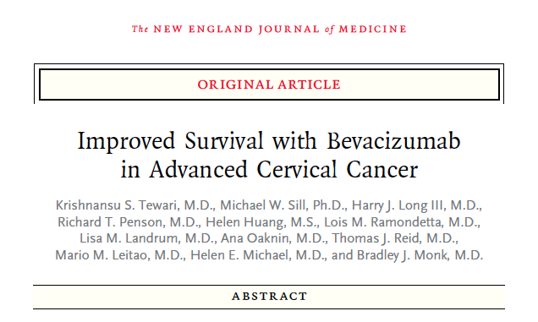
New England Journal of Medicine February 20, 2014
Tewari KS, et al. N Engl J Med. 2014;370(8):734-743.

Slide 36


Final Protocol-Specified Overall Survival Analysis of the Phase III Randomized Trial of Chemotherapy With and Without Bevacizumab for Advanced Cervical Cancer: A NRG Oncology – Gynecologic Oncology Group Study
GOG 240.6
KS Tewari, MW Sill, RT Penson, H Huang, LM Ramondetta, LM Landrum, A Oaknin, TJ Reid, MM Leitao, H Michael, BJ Monk
Presented at: ESMO 2014
Abstract LBA26

Slide 37
GOG 240.6: Final Protocol-Specified OS ChemoRx vs ChemoRx Plus Bev
 | No Bev (n = 225) | Bevacizumab (n = 227)
Events, n (%) | 178 (79) | 170 (75)
Median OS, months | 13.3 | 16.8
 | HR = 0.765 (95% CI, 0.62–0.95) P = .0068
1.0
0.8
0.6
Proportion Surviving
0.4
0.2
0.0
0
12
24
36
48
60
Months on Study
Bev
No Bev
227 142 75 30 6 0
225 114 54 17 2 0
Tewari KS, et al. Ann Oncol. 2014;25(Suppl 4): Abstract LBA26.
Notes:
On March 7, 2014, 348 deaths had occurred and the regimens administering bevacizumab continued to demonstrate a significant improvement in OS over chemotherapy alone: 16.8 mos vs 13.3 mos; HR 0.765 (95% CI: 0.62, 0.95; p=0.0068). Overall, a total of 20 patients who had been ttreated on the chemotherapy alone arms went on to receive salvage therapy with bevacizumab.

Slide 38
GOG 240.6: FINAL Protocol-Specified OS Cis-Pac vs Cis-Pac-Bev
 | Cis + Pac (n = 114) | Cis + Pac + Bev (n = 115)
Events, n (%) | 92 (81) | 83 (72)
Median OS, months | 15.0 | 17.5
 | HR = 0.73 (95% CI, 0.54–0.99) P = .04
1.0
0.8
0.6
Proportion Surviving
0.4
0.2
0.0
0
12
24
36
48
60
Months on Study
Bev
No Bev
115 73 41 16 3 0
114 63 31 11 1 0
Tewari KS, et al. Ann Oncol. 2014;25(Suppl 4): Abstract LBA26.
Notes:
The hazard of death associated with treatment with the cisplatin-paclitaxel-bevacizumab triplet compared to cisplatin-paclitaxel alone is 0.73.

Slide 39
GOG 240: Study Team and Support
Study Design
KS Tewari (PI & Study Chair)
MW Sill (Statistician)
BJ Monk (GOG Cervix Chair)
HJ Long III (Med Onc) (1946-2013)
Co-Authors
L Ramondetta, L Landrum, T Reid, M Leitao
A Oaknin (GEICO)
RT Penson (HRQoL)
H Michael (Pathology)
Co-Investigators
MJ Birrer, H Lankes, KM Darcy, RA Burger (Translational)
DH Moore (Prognostic factors)
S Waggoner (Smoking)
Genentech/Roche (USMA)
K Look, A Husain, A Cannon
GOG
PJ DiSaia (Group Chair)
MF Brady, F Stehman
L Reese, A Kuras
M Colahan, K Neff
CTEP/NCI
J Zujewski, T Trimble
J Abrams, M Mooney
L Rubenstein
UC Irvine
J Smith (Study Nurse)
A Wallick (Data Management)
Notes:
On behalf of the study team and the Gynecologic Oncology Group, I would like to thank the NCI and Genetech/Roche, as well as the patients, families and investigators that participated on this trial.

Slide 40
Immunotherapy: The Next Frontier
Eskander RN, et al. Clinical Therapeutics. 2015;37(1).

Slide 41
Immunotherapy: The Vaccines
Eskander RN, et al. Clinical Therapeutics. 2015;37(1).

Slide 42
ADXS-HPV (ADXs11-001)
Eskander RN, et al. Clinical Therapeutics. 2015;37(1).

Slide 43
Advaxis Technologies
Lm-LLO proprietary cancer immunotherapy platform technology
Live attenuated bacteria stimulate the immune system to view tumor as a bacterial infection for elimination
Alters the tumor microenvironment by increasing cells beneficial in fighting
tumors
3 immunotherapies in clinical development
ADXS-HPV (ADXS-HPV): Plan to initiate pivotal phase III program, 2014
Long-term survival and objective tumor responses in 109 patients with recurrent cervical cancer
Conducted EOP2 with FDA in July and planning to file SPA in November 2014
PD-L1 combination trial with AstraZeneca/MedImmune to initiate Q1 2015
ADXS-cHER2 (ADXS31-164): Plan to file IND for HER2 overexpressing cancers , 2014
Statistically significant survival data in canine osteosarcoma, licensed to Aratana Therapeutics
Provides rationale to pursue HER2-overexpressing cancer in humans
ADXS-PSA (ADXS-PSA): Plan to file IND and initiate phase I/II in prostate cancer, 2014
PD-1 Combination trial with Merck to initiate Q1 2015
http://www.advaxis.com
Notes:
Advaxis is focused on the HOTTEST area of cancer research - immunotherapy. Our proprietary cancer immunotherapy platform is initially being developed to address HPV-associated cancers. New treatments for HPV-associated invasive cancers are truly needed.
Our technology uses live, attenuated bacteria to trick the immune system to attack a tumor as if it is a bacterial infection.
Using our proprietary immunotherapy, we have already shown improved survival and objective tumor responses in a Phase 2 study of 110 women with recurrent cervical cancer.
Building on this data, we plan to initiate registration phase 3 trials this year with our lead immunotherapy ADXS-HPV.
Also this year, we plan to expand our clinical development by initiating two Phase 1 trials --- one in prostate cancer and one in breast cancer.
Our platform technology lends itself to multiple licensing opportunities. We recently licensed ADXS-HPV in Asia and anticipate other regional deals to follow.
We are also pursuing partners for our animal-health immunotherapy platform which we reported encouraging survival data in canine osteosarcoma with our second immunotherapy. Clinical success with two compounds has validated our platform technology and opened the door for many potential partner discussions.
Lastly, we have low cost manufacturing associated with our immunotherapies, two orphan drug designations for HPV-associated head & neck cancer and anal cancer, and a strong balance sheet with no debt as a result of a recent oversubscribed financing of $26.5M.

Slide 44
Advaxis Clinical Pipeline
Product | Indication | Pre | Phase I | Phase II | Phase III
ADXS-HPV | Cervical*
 | Cervical*
 | Cervical¹*
 | Head and neck¹*
 | Head and neck²*
 | Anal³*
ADXS-PSA | Prostate⁴
ADXS-cHER2 | Pediatric osteosarcoma*
Completed phase II in India
Phase II on-going through GOG
Plan to Initiate phase I/II
Plan to Initiate phase I/II
Phase I/II on-going
Phase I/II on-going
Plan to initiate phase I/II
1 Partnership w/ MedImmune (AZ)
2 Icahn School of Medicine at Mount Sinai
3 BrUOG: Brown University Oncology Group
4 Partnership w/ Merck
*Orphan drug designation
Projected 2015
Notes:
Based on this technology, we have created this robust clinical pipeline that includes substantial data and clinical experience from several clinical trials including a large phase 2 in 110 women with recurrent cervical cancer who had failed chemotherapy/ radiation, or both.
Our Initial clinical immunotherapy, ADXS-HPV, targets cancers caused by the Human Pap Virus or HPV. The HPV-associated cancers that we are clinically developing include head & neck cancer and anal cancer. Both of these programs are already in Phase 1. However HPV-associated cancers are just the beginning.
Poised and nearly ready to go into the clinic are additional constructs, ADXS-PSA for prostate cancer and ADXS HER-2, for HER2+ breast cancer.
We are also studying the use of our proprietary ADXS immunotherapies in vet applications. ADXS-HER2 is being studied in a clinical trial in HER2 over-expressing canine osteosarcoma. I take you through this data you’ll see that our immunotherapy has shown improved survival and provides additional rationale for moving into breast cancer in humans with the HER-2 construct.

Slide 45
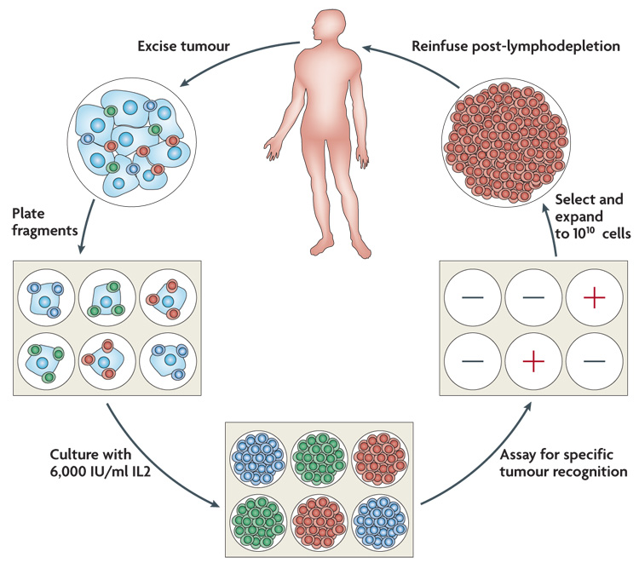
Adoptive T Cell Transfer Using Tumor-infiltrating Lymphocytes
Rosenberg SA, et al. Nat Rev Cancer. 2008;8(4):299-308.

Slide 46


HPV-Targeted Tumor-Infiltrating Lymphocytes for Metastatic Cervical Cancer
Hinrichs CS, Stevanović S, Draper L, Somerville R, Wunderlich J, Restifo NP, Sherry R, Phan GQ, Kammula US, Yang JC, Rosenberg SA
Presented at: ASCO Annual Meeting 2014
Abstract LBA3008

Slide 47
Patient Characteristics
Patient | Age | Histology | HPV type | Prior systemic therapy | Cell dose (x10⁹) | Response (duration in months)*
1 | 30 | Adeno-squamous | HPV-18 | Cisplatin | 101 | PD
2 | 53 | Squamous | HPV-18 | Cisplatin, paclitaxel, carboplatin, topotecan, ixabepilone, phase I trial | 126 | PR (3)
3 | 36 | Squamous | HPV-16 | Bleomycin, vincristine, cisplatin, gemcitabine, topotecan, paclitaxel | 152 | CR (22+)
4 | 55 | Squamous | HPV-16 | Carboplatin, 5-FU, irinotecan | 80 | PD
5 | 44 | Squamous | HPV-18 | Cisplatin | 90 | PD
6 | 36 | Adeno | HPV-18 | Cisplatin | 75 | CR (15+)
7 | 59 | Adeno | HPV-18 | Cisplatin, carboplatin, paclitaxel, bevacizumab | 33 | PD
8 | 31 | Adeno-squamous | HPV-18 | Cisplatin, paclitaxel | 46 | PD
9 | 37 | Adeno | HPV-18 | Carboplatin, paclitaxel, ipilimumab | 70 | PD
* Duration measured in months from cell infusion
Hinrichs CS, et al. J Clin Oncol. . 2014;32(5s): Abstract LBA3008.

Slide 48
Checkpoint Inhibition: Overcoming Immune Tolerance
Lebbe C, et al. Presented at: 33rd European Society for Medical Oncology Congress; September 12-16, 2008; Stockholm, Sweden.

Slide 49
Monoclonal Antibodies Directed Against PD-1, or Its Ligands, Promote T cell Activation by Shifting the Balance of Signals Delivered by the DC from Suppressive to Activating
Eskander RN, et al. Clinical Therapeutics. 2015;37(1).

Slide 50
T cells Engineered to Express Chimeric Antigen Receptors or “CARs” That Recognize Surface Antigens in an MHC-Unrestricted Manner
Eskander RN, et al. Clinical Therapeutics. 2015;37(1).

Slide 51
BiTE Molecule Forming Cytolytic Synapse Between Tumor Cell Expressing Target of Interest and T cell
Eskander RN, et al. Clinical Therapeutics. 2015;37(1).

Slide 52

Thank You
Bradley.monk@chw.edu

